Slide 1
Sorting

Slide 2
Sorting
Sorting refers to arranging data in a particular format.
Sorting algorithm specifies the way to arrange data in a particular order.
Most common orders are in numerical or lexicographical order.

Slide 3
Sorting
The importance of sorting lies in the fact that data searching can be optimized to a very high level, if data is stored in a sorted manner.
Sorting is also used to represent data in more readable formats

Slide 4
Sorting
Some real-life scenarios −
Telephone Directory − The telephone directory stores the telephone numbers of people sorted by their names, so that the names can be searched easily.
Dictionary − The dictionary stores words in an alphabetical order so that searching of any word becomes easy.

Slide 5
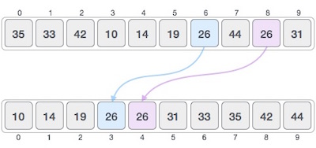
Stable and Not Stable Sorting
If a sorting algorithm, after sorting the contents, does not change the sequence of similar content in which they appear, it is called stable sorting.

Slide 6
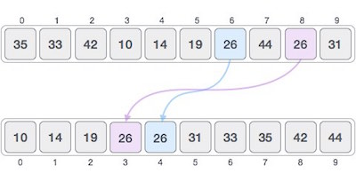
Stable and Not Stable Sorting
If a sorting algorithm, after sorting the contents, changes the sequence of similar content in which they appear, it is called unstable sorting.

Slide 7
Stable and Not Stable Sorting
Stability of an algorithm matters when we wish to maintain the sequence of original elements, like in a tuple for example.

Slide 8
Stable and Not Stable Sorting
Stability is mainly important when we have key value pairs with duplicate keys possible (like people names as keys and their details as values). And we wish to sort these objects by keys.
What is it? A sorting algorithm is said to be stable if two objects with equal keys appear in the same order in sorted output as they appear in the input array to be sorted.

Slide 9
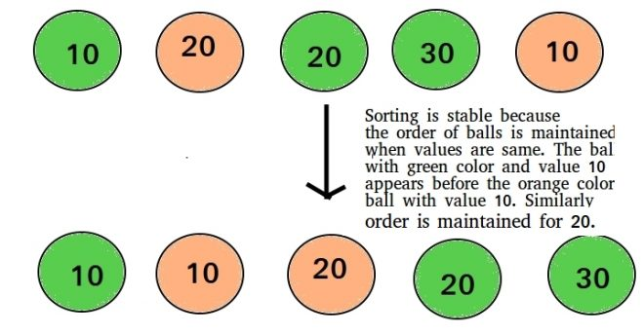
Stable and Not Stable Sorting

Slide 10
Bubble Sort
Bubble sort is an algorithm that compares the adjacent elements and swaps their positions if they are not in the intended order.

Slide 11
Bubble Sort
For sorting N elements, The steps are-
Pass 1
First Compare 1st element with 2nd element of array, If 1st >2nd , swap the elements else If 1st<2nd then compare 2nd with 3rd
If 2nd>3rd then interchange value of 2nd and 3rd
Now compare 3rd value with 4th
Similarly compare until N-1th element is compared with Nth element
Now the highest value is reached at Nth place
Pass 2
Now elements will be compared until N-1 elements

Slide 12
Bubble Sort
In each iteration, the comparison takes place up to the last unsorted element.
The array is sorted when all the unsorted elements are placed at their correct positions.

Slide 13
Bubble Sort
Let the elements be-
13,32,20,62,68,52,38,46
Pass1
Compare 1st ,2nd element, 13<32 No change
Compare 2nd,3rd element, 32>20,Interchange
13,20,32,62,68,52,38,46

Slide 14
Bubble Sort
13,20,32,62,68,52,38,46
Compare 3rd,4th element, 32<62 No change
Compare 4th,5th element, 62<68 No change
Compare 5th,6th element, 68>52 Interchange
13,20,32,62,52,68,38,46
Compare 6th,7th element, 68>38 Interchange
13,20,32,62,52,38,68,46
Compare 7th ,8th element, 68>46 Interchange
13,20,32,62,52,38,46,68
Pass 1 completed,
The Biggest element has reached the last position

Slide 15
Bubble Sort
13,20,32,62,52,38,46,68
Pass 2
Now showing only interchange
62>52, so 13,20,32,52,62,38,46,68
62>38, so 13,20,32,52,38,62,46,68
62>46 so 13,20,32,52,38,46,62,68
After Pass 2, second largest element reaches 2nd last position

Slide 16
Bubble Sort
13,20,32,52,38,46,62,68
Pass 3
Now showing only interchange
52>38 so 13,20,32,38,52,46,62,68
52>46 so 13,20,32,38,46,52,62,68
After Pass 3, 3rd largest element reaches 3r^{d} last position
13,20,32,38,46,52,62,68
Pass 4
No of Exchanges=0, so list is sorted

Slide 17
Bubble Sort
Analysis-
This algorithm is not suitable for large data sets as its average and worst case complexity are of Ο(n²) where n is the number of items.
It behaves as O(n) for Sorted array

Slide 18
Bubble Sort
How many Passes are needed to sort the following list of numbers? 5 1 4 2 8

Slide 19
Bubble Sort
First Pass: ( 5 1 4 2 8 ) –> ( 1 5 4 2 8 ), Here, algorithm compares the first two elements, and swaps since 5 > 1. ( 1 5 4 2 8 ) –> ( 1 4 5 2 8 ), Swap since 5 > 4 ( 1 4 5 2 8 ) –> ( 1 4 2 5 8 ), Swap since 5 > 2 ( 1 4 2 5 8 ) –> ( 1 4 2 5 8 ), Now, since these elements are already in order (8 > 5), algorithm does not swap them.
Second Pass: ( 1 4 2 5 8 ) –> ( 1 4 2 5 8 ) ( 1 4 2 5 8 ) –> ( 1 2 4 5 8 ), Swap since 4 > 2 ( 1 2 4 5 8 ) –> ( 1 2 4 5 8 ) ( 1 2 4 5 8 ) –> ( 1 2 4 5 8 ) Now, the array is already sorted, but our algorithm does not know if it is completed. The algorithm needs one whole pass without any swap to know it is sorted.
Third Pass: ( 1 2 4 5 8 ) –> ( 1 2 4 5 8 ) ( 1 2 4 5 8 ) –> ( 1 2 4 5 8 ) ( 1 2 4 5 8 ) –> ( 1 2 4 5 8 ) ( 1 2 4 5 8 ) –> ( 1 2 4 5 8 )

Slide 20
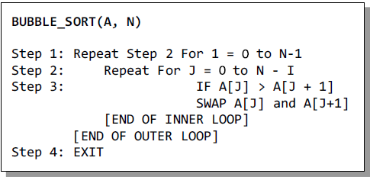
Bubble Sort
Algorithm-

Slide 21
Bubble Sort
// A function to implement bubble sort
void bubbleSort(int arr[], int n)
{
int i, j;
for (i = 0; i < n-1; i++)
// Last i elements are already in place
for (j = 0; j < n-i-1; j++)
if (arr[j] > arr[j+1])
swap(&arr[j], &arr[j+1]);
}

Slide 22
Bubble Sort
// A function to implement bubble sort
void bubbleSort(int arr[], int n)
{
int i, j;
for (i = 0; i < n-1; i++)
// Last i elements are already in place
for (j = 0; j < n-i-1; j++)
if (arr[j] > arr[j+1])
swap(&arr[j], &arr[j+1]);
}

Slide 23
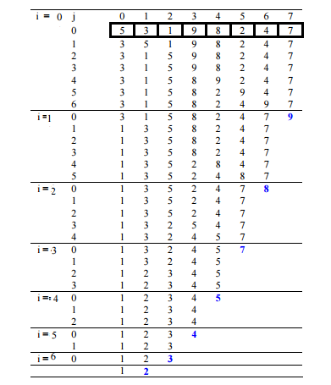
Bubble Sort

Slide 24
Counting Sort
Counting sort is a sorting algorithm that sorts the elements of an array by counting the number of occurrences of each unique element in the array.

Slide 25
Counting Sort
Database needed-
Original Array/Input Array
Count Array/Auxillary Array
Take a count array to store the count of each unique object.
Store the count of each element at their respective index in count array
For example: if the count of element 3 is 2 then, 2 is stored in the 3rd position of count array.
If element "5" is not present in the array, then 0 is stored in 5th position.

Slide 26
Counting Sort
Store cumulative sum of the elements of the count array. It helps in placing the elements into the correct index of the sorted array.
The modified count array indicates the position of each object in the output sequence.
After placing each element at its correct position, decrease its count by one.

Slide 27
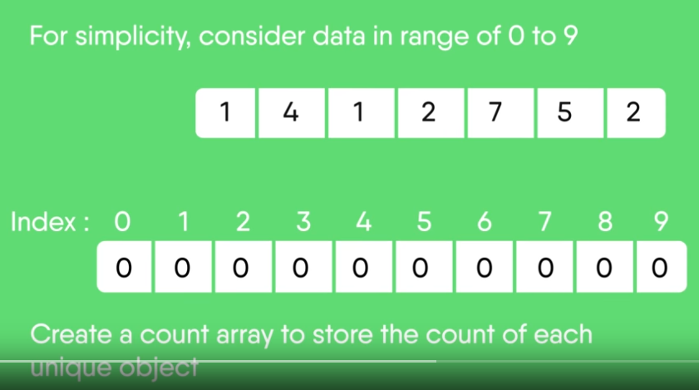
Counting Sort
Let us take an auxiliary array/count array from 0 to 9 for simplicity

Slide 28
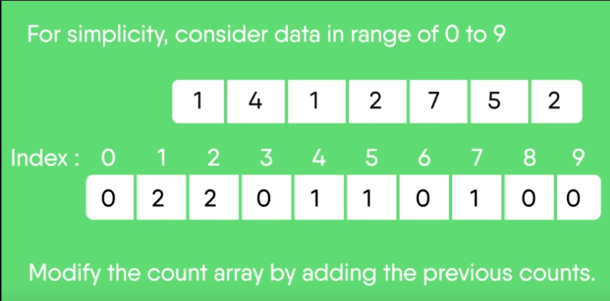
Counting Sort

Slide 29
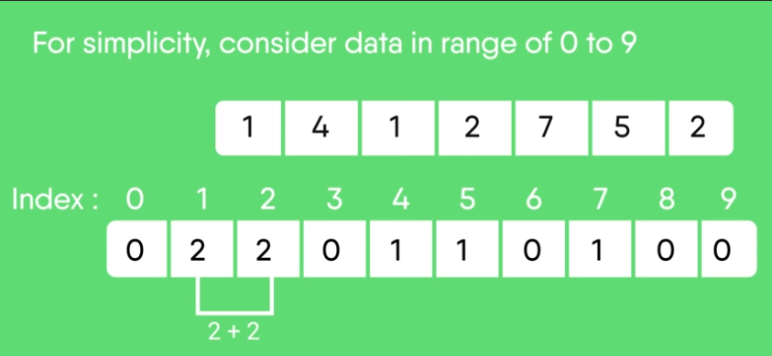
Counting Sort

Slide 30
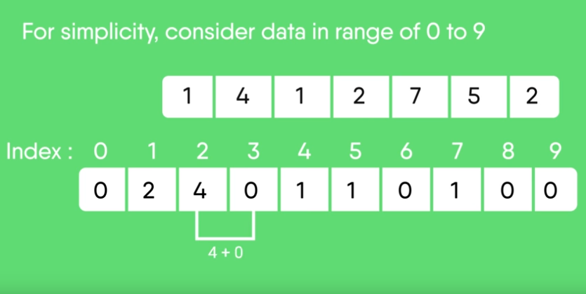
Counting Sort

Slide 31
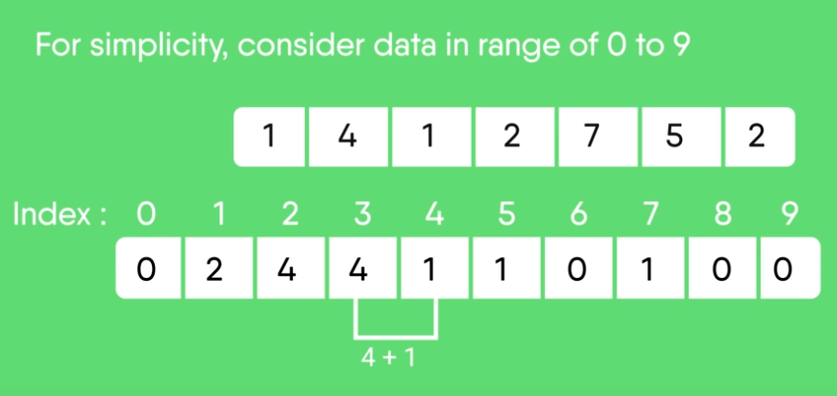
Counting Sort

Slide 32
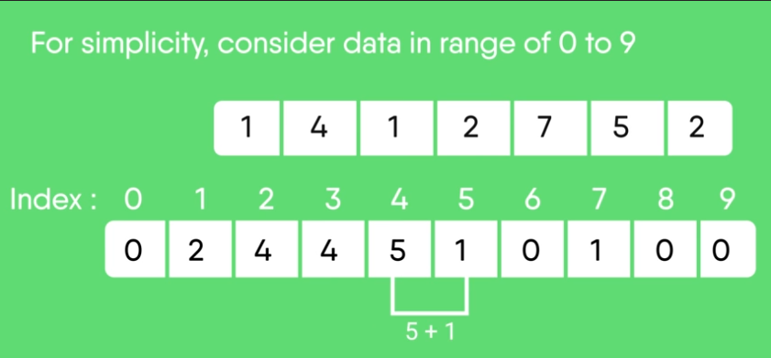
Counting Sort

Slide 33
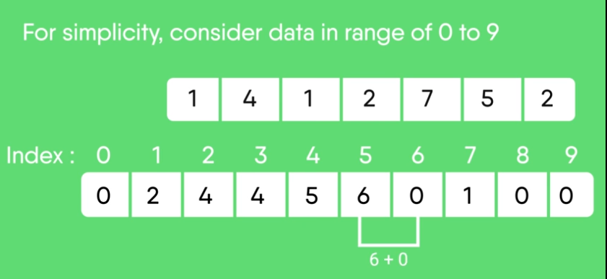
Counting Sort

Slide 34
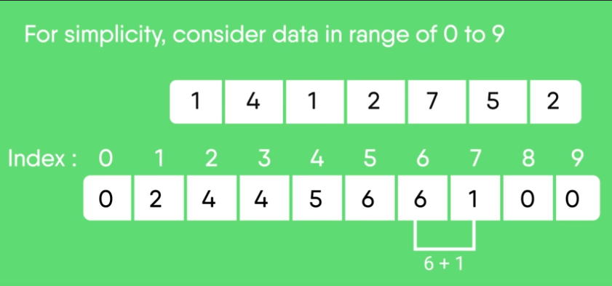
Counting Sort

Slide 35
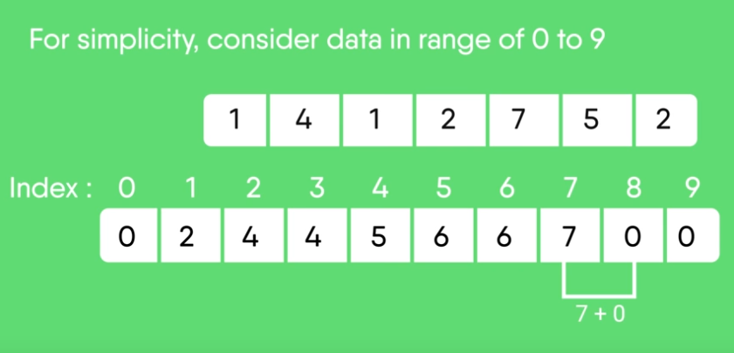
Counting Sort

Slide 36

Counting Sort

Slide 37
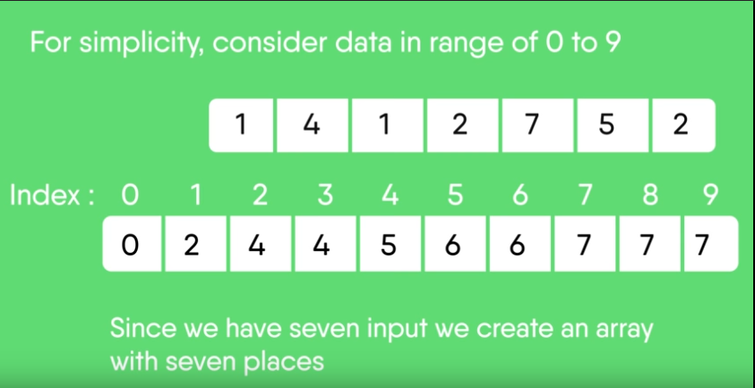
Counting Sort

Slide 38
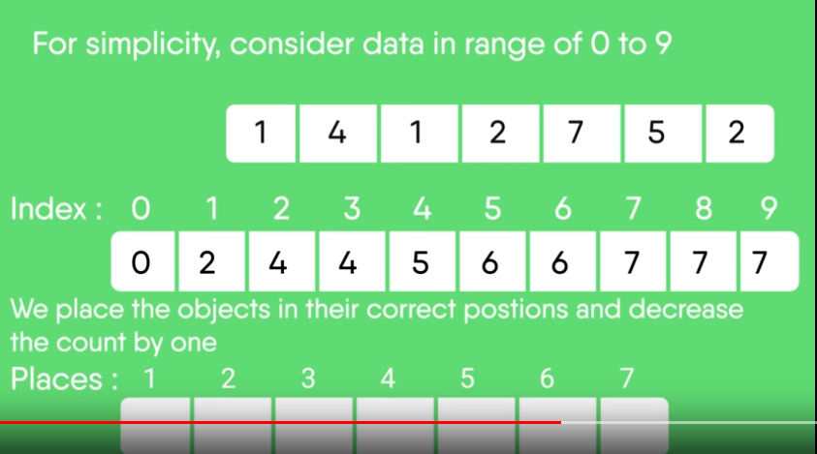
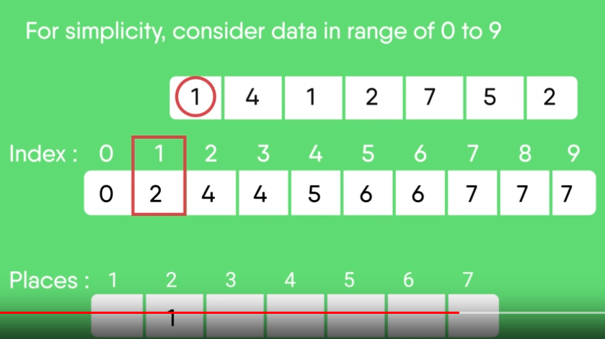
Counting Sort

Slide 39
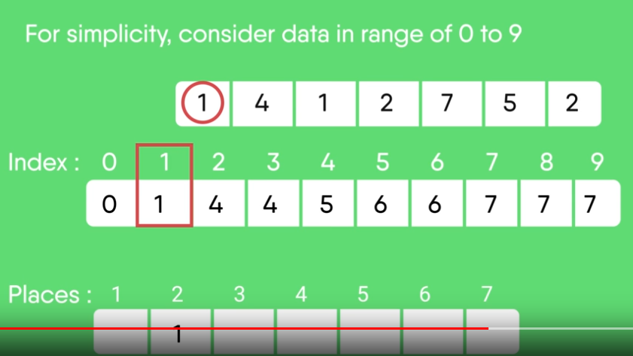
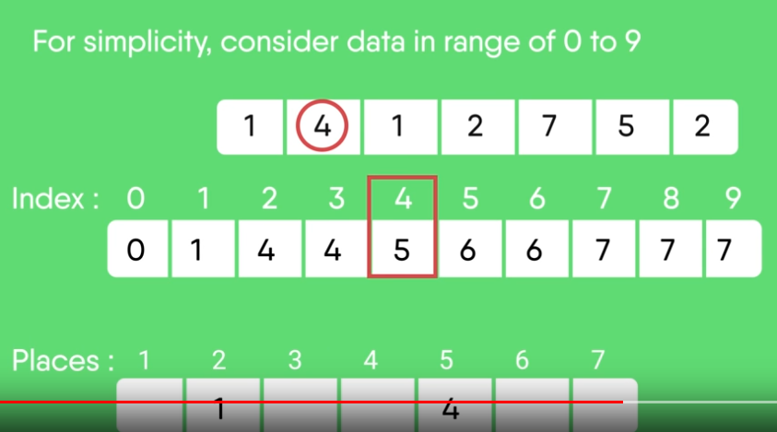
Counting Sort

Slide 40

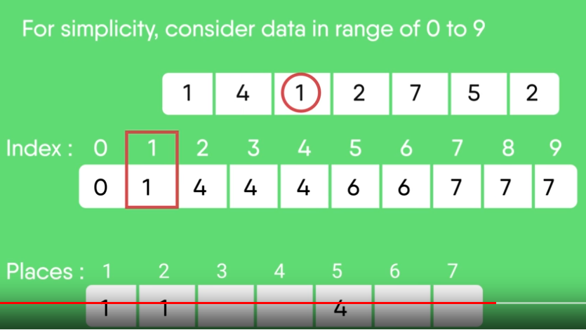
Counting Sort

Slide 41
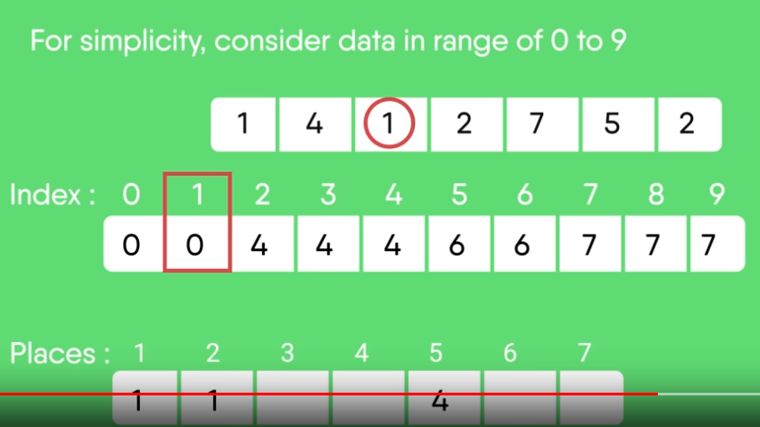
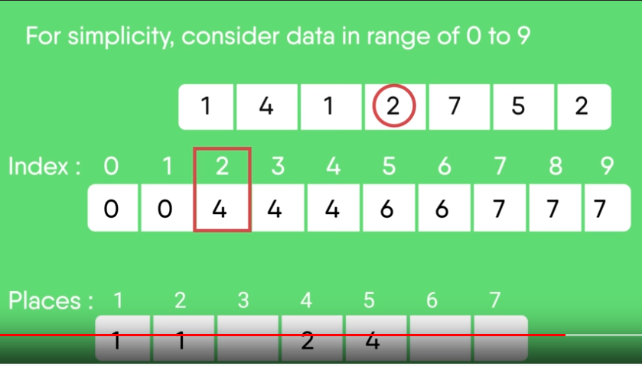
Counting Sort

Slide 42
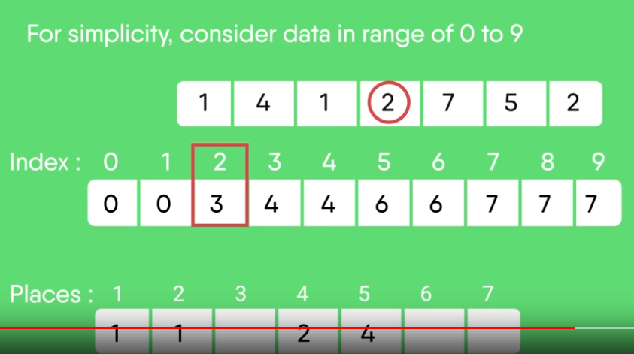
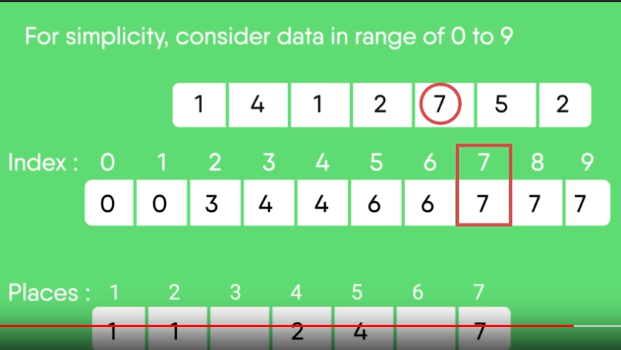
Counting Sort

Slide 43

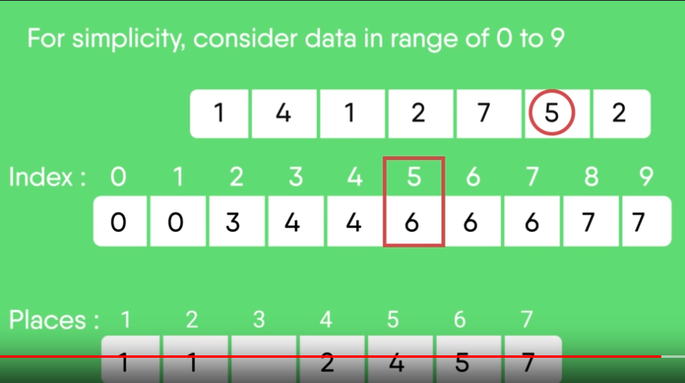
Counting Sort

Slide 44
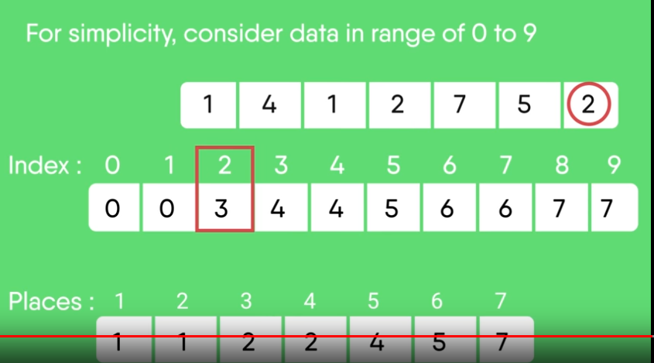
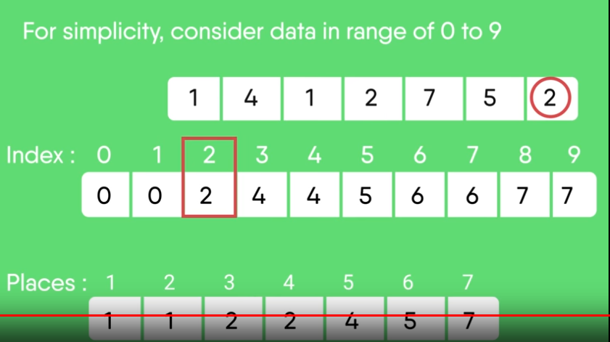
Counting Sort

Slide 45
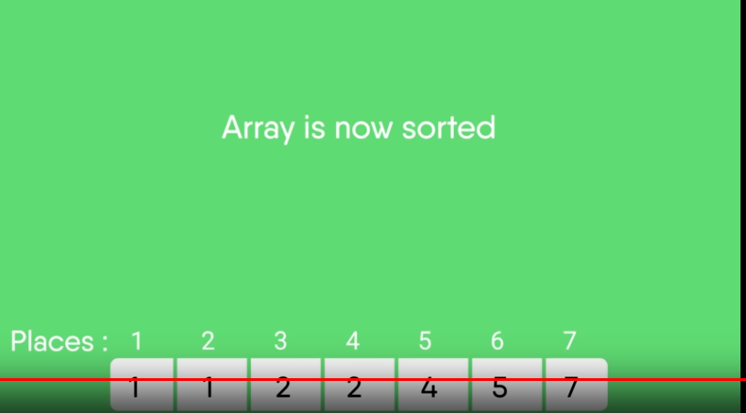
Counting Sort

Slide 46
Example 2
8 | 4 | 2 | 2 | 8 | 3 | 3 | 1
Sort the array of 8 elements using Counting Sort

Slide 47
Example 2
8 | 4 | 2 | 2 | 8 | 3 | 3 | 1
Let us take an auxiliary array/count array from 0 to 9 for simplicity

Slide 48
Example 2
8 | 4 | 2 | 2 | 8 | 3 | 3 | 1
Sort the array of 8 elements using Counting Sort
0 | 1 | 2 | 3 | 4 | 5 | 6 | 7 | 8 | 9
0 | 1 | 2 | 2 | 1 | 0 | 0 | 0 | 2 | 0

Slide 49
Example 2
8 | 4 | 2 | 2 | 8 | 3 | 3 | 1
Sort the array of 8 elements using Counting Sort
Cumulative Count array –
0 | 1 | 2 | 3 | 4 | 5 | 6 | 7 | 8 | 9
0 | 1 | 2 | 2 | 1 | 0 | 0 | 0 | 2 | 0
0 | 1 | 2 | 3 | 4 | 5 | 6 | 7 | 8 | 9
0 | 1 | 3 | 5 | 6 | 6 | 6 | 6 | 8 | 8

Slide 50
Example 2
8 | 4 | 2 | 2 | 8 | 3 | 3 | 1
Cumulative Count array –
Place the objects in the correct place and decrease the count by 1
Check for Object 8, Count=8,
Place at 8th Position and decrement count by 1
Cumulative Count Array-
0 | 1 | 2 | 3 | 4 | 5 | 6 | 7 | 8 | 9
0 | 1 | 3 | 5 | 6 | 6 | 6 | 6 | 8 | 8
1 | 2 | 3 | 4 | 5 | 6 | 7 | 8
 |  |  |  |  |  |  | 8
0 | 1 | 2 | 3 | 4 | 5 | 6 | 7 | 8 | 9
0 | 1 | 3 | 5 | 6 | 6 | 6 | 6 | 7 | 8

Slide 51
Example 2
8 | 4 | 2 | 2 | 8 | 3 | 3 | 1
Cumulative Count array –
Place the objects in the correct place and decrease the count by 1
Check for Object 4, Count=6,
Place at 6th Position and decrement count by 1
Cumulative Count Array-
0 | 1 | 2 | 3 | 4 | 5 | 6 | 7 | 8
0 | 1 | 3 | 5 | 6 | 6 | 6 | 6 | 7
1 | 2 | 3 | 4 | 5 | 6 | 7 | 8
 |  |  |  |  | 4 |  | 8
0 | 1 | 2 | 3 | 4 | 5 | 6 | 7 | 8
0 | 1 | 3 | 5 | 5 | 6 | 6 | 6 | 7

Slide 52
Example 2
8 | 4 | 2 | 2 | 8 | 3 | 3 | 1
Cumulative Count array –
Place the objects in the correct place and decrease the count by 1
Check for Object 2, Count=3,
Place object at 3th Position and decrement count by 1
Cumulative Count Array-
0 | 1 | 2 | 3 | 4 | 5 | 6 | 7 | 8
0 | 1 | 3 | 5 | 5 | 6 | 6 | 6 | 7
1 | 2 | 3 | 4 | 5 | 6 | 7 | 8
 |  | 2 |  |  | 4 |  | 8
0 | 1 | 2 | 3 | 4 | 5 | 6 | 7 | 8
0 | 1 | 2 | 5 | 5 | 6 | 6 | 6 | 7

Slide 53
Example 2
8 | 4 | 2 | 2 | 8 | 3 | 3 | 1
Cumulative Count array –
Place the objects in the correct place and decrease the count by 1
Check for Object 2, Count=2,
Place object at 2nd Position and decrement count by 1
Cumulative Count Array-
0 | 1 | 2 | 3 | 4 | 5 | 6 | 7 | 8
0 | 1 | 2 | 5 | 5 | 6 | 6 | 6 | 7
1 | 2 | 3 | 4 | 5 | 6 | 7 | 8
 | 2 | 2 |  |  | 4 |  | 8
0 | 1 | 2 | 3 | 4 | 5 | 6 | 7 | 8
0 | 1 | 1 | 5 | 5 | 6 | 6 | 6 | 7

Slide 54
Example 2
8 | 4 | 2 | 2 | 8 | 3 | 3 | 1
Cumulative Count array –
Place the objects in the correct place and decrease the count by 1
Check for Object 8, Count=7,
Place object at 7th Position and decrement count by 1
Cumulative Count Array-
0 | 1 | 2 | 3 | 4 | 5 | 6 | 7 | 8
0 | 1 | 1 | 5 | 5 | 6 | 6 | 6 | 7
1 | 2 | 3 | 4 | 5 | 6 | 7 | 8
 | 2 | 2 |  |  | 4 | 8 | 8
0 | 1 | 2 | 3 | 4 | 5 | 6 | 7 | 8
0 | 1 | 1 | 5 | 5 | 6 | 6 | 6 | 6

Slide 55
Example 2
8 | 4 | 2 | 2 | 8 | 3 | 3 | 1
Cumulative Count array –
Place the objects in the correct place and decrease the count by 1
Check for Object 3, Count=5,
Place object at 5th Position and decrement count by 1
Cumulative Count Array-
0 | 1 | 2 | 3 | 4 | 5 | 6 | 7 | 8
0 | 1 | 1 | 5 | 5 | 6 | 6 | 6 | 7
1 | 2 | 3 | 4 | 5 | 6 | 7 | 8
 | 2 | 2 |  | 3 | 4 | 8 | 8
0 | 1 | 2 | 3 | 4 | 5 | 6 | 7 | 8
0 | 1 | 1 | 4 | 5 | 6 | 6 | 6 | 6

Slide 56
Example 2
8 | 4 | 2 | 2 | 8 | 3 | 3 | 1
Cumulative Count array –
Place the objects in the correct place and decrease the count by 1
Check for Object 3, Count=4,
Place object at 5th Position and decrement count by 1
Cumulative Count Array-
0 | 1 | 2 | 3 | 4 | 5 | 6 | 7 | 8
0 | 1 | 1 | 4 | 5 | 6 | 6 | 6 | 7
1 | 2 | 3 | 4 | 5 | 6 | 7 | 8
 | 2 | 2 | 3 | 3 | 4 | 8 | 8
0 | 1 | 2 | 3 | 4 | 5 | 6 | 7 | 8
0 | 1 | 1 | 3 | 5 | 6 | 6 | 6 | 6

Slide 57
Example 2
8 | 4 | 2 | 2 | 8 | 3 | 3 | 1
Cumulative Count array –
Place the objects in the correct place and decrease the count by 1
Check for Object 1, Count=1,
Place object at 1st Position and decrement count by 1
Cumulative Count Array-
0 | 1 | 2 | 3 | 4 | 5 | 6 | 7 | 8
0 | 1 | 1 | 4 | 5 | 6 | 6 | 6 | 7
1 | 2 | 3 | 4 | 5 | 6 | 7 | 8
1 | 2 | 2 | 3 | 3 | 4 | 8 | 8
0 | 1 | 2 | 3 | 4 | 5 | 6 | 7 | 8
0 | 0 | 1 | 3 | 5 | 6 | 6 | 6 | 6

Slide 58
Example 2
Input Array-
Sorted array-
8 | 4 | 2 | 2 | 8 | 3 | 3 | 1
Position | 1 | 2 | 3 | 4 | 5 | 6 | 7 | 8
Value | 1 | 2 | 2 | 3 | 3 | 4 | 8 | 8

Slide 59
Insertion Sort-

Slide 60
Insertion Sort-
Incremental algorithm.
Considers the elements one at a time,
Inserting each in its suitable place among those already considered (keeping them sorted).
It builds the sorted sequence one number at a time.

Slide 61
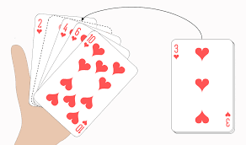
Insertion Sort-
Similar to the way you sort playing cards in your hands.
The array is virtually split into a sorted and an unsorted part.
Values from the unsorted part are picked and
Placed at the correct position in the sorted part.

Slide 62
Insertion Sort-
Suppose a[0], a[1], a[2], …………….,a[n-1] are n elements in memory, insertion sort works as follow:
Pass 1: a[0] by itself is trivially sorted.
Pass 2: a[1] is inserted either
before or after a[0] so that a[0], a[1] is sorted.
Pass 3: a[2] is inserted into its proper place in a[0],a[1],
that is before a[0],
between a[0] and a[1],
or after a[1],
so that: a[0],a[1], a[2] is sorted.
……
……
Pass n: a[n-1] is inserted into its proper place in a[0], a[1], a[2], ……….a[n-2] so that a[0], a[1], a[2], ……….a[n-1] is sorted array with ‘n’ elements

Slide 63
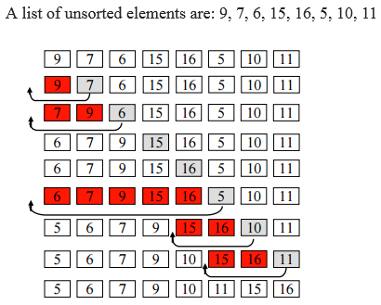
Insertion Sort-
Pass 1
Pass 2
Pass 3
Pass 4
Pass 5
Pass 6
Pass 7
Pass 8
Pass 9

Slide 64
Algorithm for Insertion Sort-
Step 1 − If it is the first element, it is already sorted. return 1;
Step 2 − Iterate from arr[1] to arr[n-1] over the array.
Pick the current element and store it separately in a key.
Step 3 − Compare the key with its predecessors i.e. all elements in the sorted sub-list
Step 4 − Shift all the elements in the sorted sub-list that are greater than the key towards the right by one position to make space for the key
Step 5 − Insert the key
Step 6 − Repeat until list is sorted

